Slide 1

OpenAI API
Chat
Completions
two

Slide 2
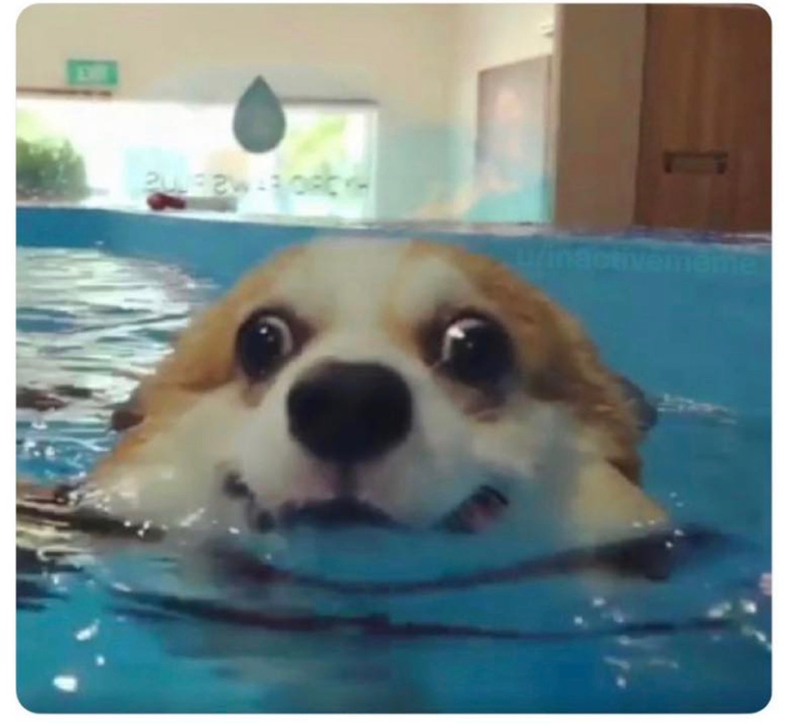

Slide 3
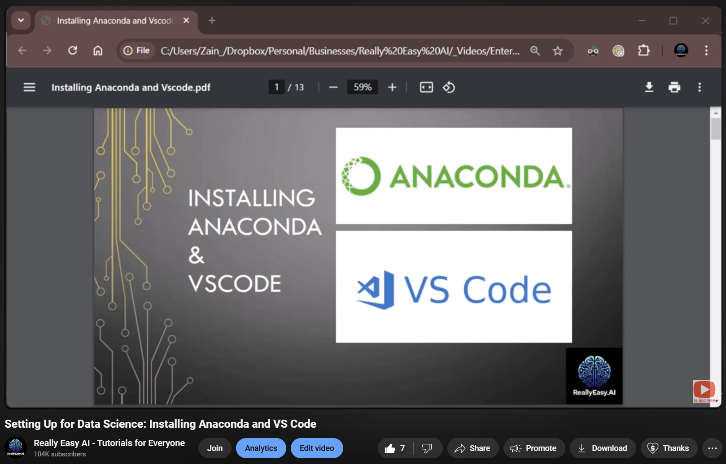
Setting up Anaconda and VS Code
Notes:
https://www.youtube.com/watch?v=50TM9pfYv5U

Slide 4
Dipping Our Toes in the Water
model
messages
response_format
temperature
stream
max_completion_tokens
stop
top_p
frequency_penalty
presence_penalty
Notes:
from openai import OpenAI
client = OpenAI()

Slide 5
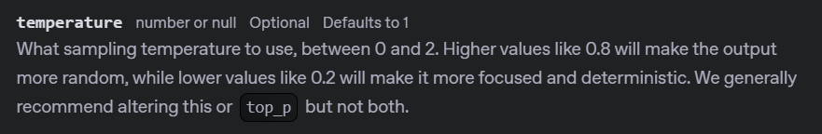
Notes:
https://platform.openai.com/docs/api-reference/chat/create#chat-create-temperature

Slide 6
completion = client.chat.completions.create(
model="gpt-4o-mini",
messages=[
{"role": "developer", "content": "You are a brilliant author of children's books."},
{"role": "user", "content": "Write two paragraphs about a frog."}
],
response_format=None,
temperature=0
)

Slide 7
DEMO: Temperature

Slide 8
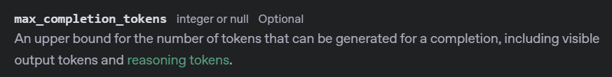
Notes:
https://platform.openai.com/docs/api-reference/chat/create#chat-create-max_completion_tokens
https://platform.openai.com/docs/models/gpt-4o-mini

Slide 9
completion = client.chat.completions.create(
model="gpt-4o-mini",
messages=[
{"role": "developer", "content": "You are a brilliant author of children's books."},
{"role": "user", "content": "Write two paragraphs about a frog."}
],
response_format=None,
temperature=None,
max_completion_tokens=1000
)

Slide 10
DEMO: Max Completion Tokens

Slide 11

Notes:
https://platform.openai.com/docs/api-reference/chat/create#chat-create-stop

Slide 12
completion = client.chat.completions.create(
model="gpt-4o-mini",
messages=[
{"role": "developer", "content": "You are a brilliant author of children's books."},
{"role": "user", "content": "Write one page about a frog."}
],
response_format=None,
temperature=None,
max_completion_tokens=None,
stop=["water","green"]
)

Slide 13
DEMO: Stop Sequences

Slide 14




Notes:
https://www.youtube.com/channel/UC35ZpwldGw7ZJ5R-2sLijzw

Slide 15
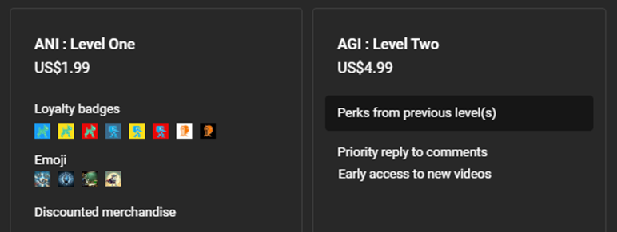
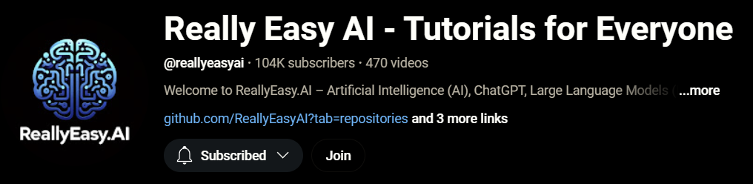
Notes:
https://www.youtube.com/@reallyeasyai/join

Slide 16

https://shop.reallyeasy.ai
Notes:
https://shop.reallyeasy.ai

Slide 17

https://www.youtube.com/@ainewsfresh
Notes:
https://www.youtube.com/@ainewsfresh

Slide 18

https://www.youtube.com/@aipaperspodcastdaily
Notes:
https://www.youtube.com/@aipaperspodcastdaily

Slide 19
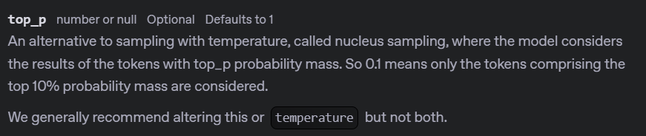
Notes:
https://platform.openai.com/docs/api-reference/chat/create#chat-create-top_p

Slide 20
completion = client.chat.completions.create(
model="gpt-4o-mini",
messages=[
{"role": "developer", "content": "You are a brilliant author of children's books."},
{"role": "user", "content": "Write two paragraphs about a frog."}
],
response_format=None,
temperature=None,
max_completion_tokens=None,
stop=None,
top_p=0.01,
)

Slide 21
DEMO: Top P (Nucleus Sampling)

Slide 22
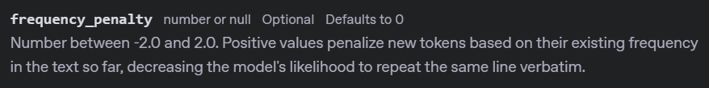
Notes:
https://platform.openai.com/docs/api-reference/chat/create#chat-create-frequency_penalty

Slide 23
completion = client.chat.completions.create(
model="gpt-4o-mini",
messages=[
{"role": "developer", "content": "You are a brilliant author of children's books."},
{"role": "user", "content": "Write two paragraphs about a frog."}
],
response_format=None,
temperature=None,
max_completion_tokens=None,
stop=None,
top_p=None,
frequency_penalty=1.5,
)

Slide 24
DEMO: Frequency Penalty

Slide 25
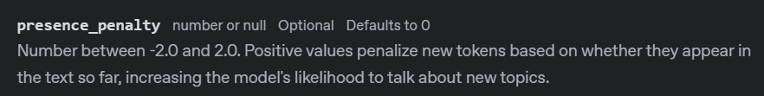
Notes:
https://platform.openai.com/docs/api-reference/chat/create#chat-create-presence_penalty

Slide 26
completion = client.chat.completions.create(
model="gpt-4o-mini",
messages=[
{"role": "developer", "content": "You are a brilliant author of children's books."},
{"role": "user", "content": "Write two paragraphs about a frog."}
],
response_format=None,
temperature=None,
max_completion_tokens=None,
stop=None,
top_p=None,
frequency_penalty=None,
presence_penalty=1.5
)

Slide 27
DEMO: Presence Penalty

Slide 28
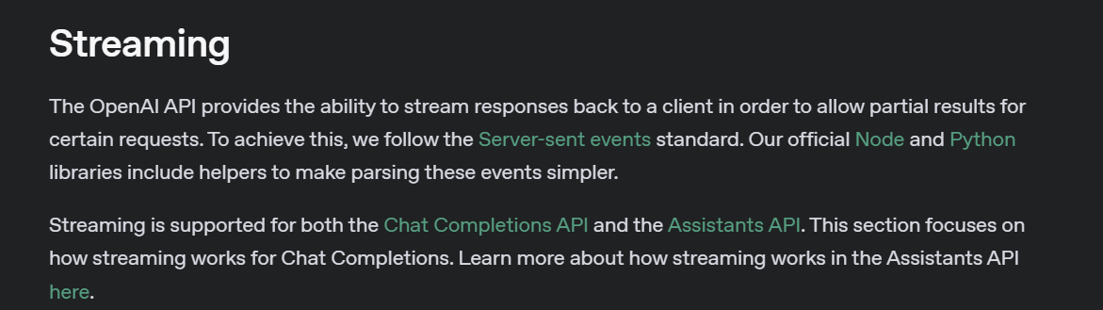
Notes:
https://platform.openai.com/docs/api-reference/streaming

Slide 29


Non-Streaming Response
How are you?
Wait for Processing
Full Response
I am great!

Slide 30
Streaming Response
How are you?
I
am
great
!

Slide 31
stream = client.chat.completions.create(
model="gpt-4o-mini",
messages=[
{"role": "developer", "content": "You are a brilliant author of children's books."},
{"role": "user", "content": "Write two paragraphs about a frog."}
],
response_format=None,
temperature=None,
max_completion_tokens=None,
stop=None,
top_p=None,
frequency_penalty=None,
presence_penalty=None,
stream=True
)

Slide 32
DEMO: Streaming Responses

Slide 33
OpenAI API
Chat
Completions
two

